Slide 1
Victron BT Smartshunt
KB7RHI

Slide 2
Power Management Problem When Using A Powerbox For Portable Operations In The Field
Powerbox can have multiple connection points
I can use an inline watt meter for loads all attached to a distribution block
I can use another inline watt meter for solar input to the battery
But what about the automotive connection port
What about the USB A or USB C port
I could have multiple connections going at once
I needed a “Gas Gauge” type device to show my battery SOC

Slide 3
The Victron BT Smartshunt is a game changer for portable operations
The Victron Smartshunt provides detailed information about your battery usage to your phone via BT…It is a “Gas Gauge” for your battery
You can see your battery state of charge represented as a percentage of battery energy left
You can see battery voltage
You can see how many amps are going into or out of your battery
You can see how many watts your battery is providing or being charged with
You can see a Time To Go reading to show how long your battery will last if conditions stay the same for a window of time you select…say 3 minutes

Slide 4
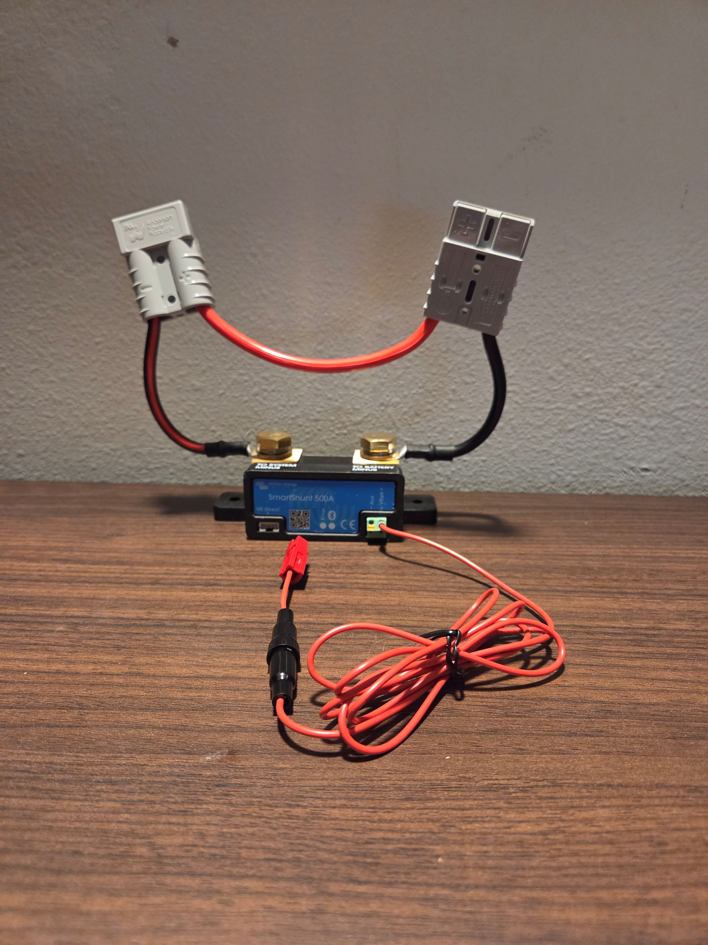
Victron BT Smartshunt configured for a Powerwerx Megabox…Looks like a creature, SHU050150050 is the model I use, the PWRbox has the black wires facing inwards

Slide 5
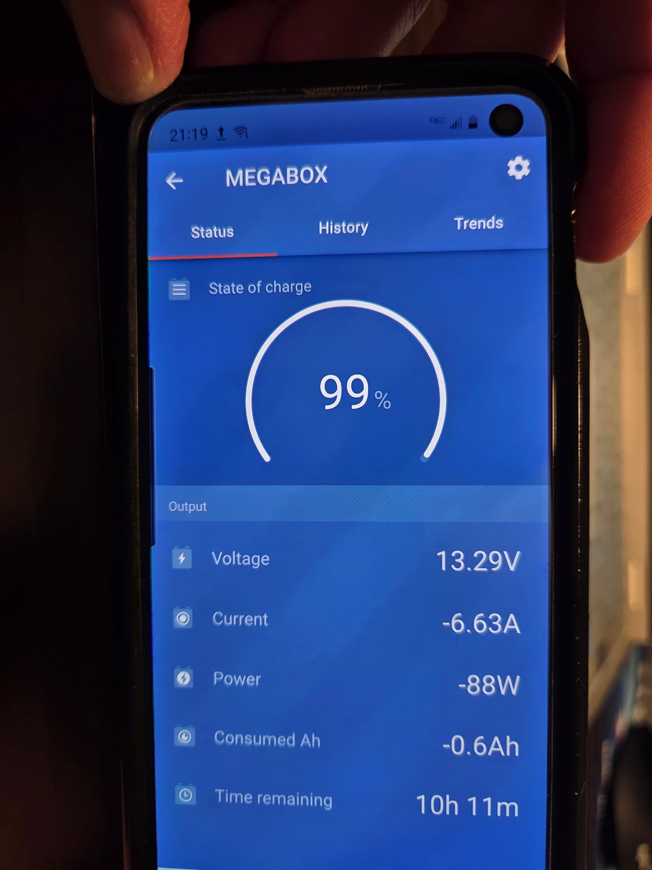
Victron Smartshunt app connected to my Megabox with screen showing SOC, Voltage, Current, Power in watts, Consumed Ah, and Time remaining

Slide 6
Live Demonstration using a Powerwerx Megabox, Powerwerx Pwrbox, and view of the shunt outside of a powerbox
Have three phones each connected to a different shunt
Make manual load adjustments while monitoring each battery
Open up the settings screen, go to “battery” and see where you adjust the settings

Slide 7
Set up the battery parameters
Will show where to set up the specific battery parameters for the shunt to use for calculations

Slide 8
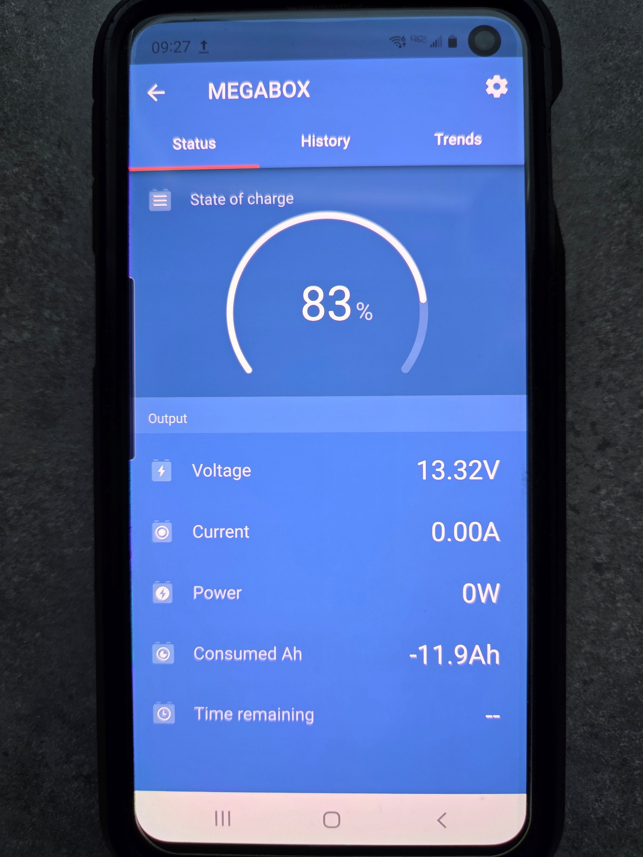
Once you come to the device main page, then click on the upper right gear symbol to get the Settings menu

Slide 9
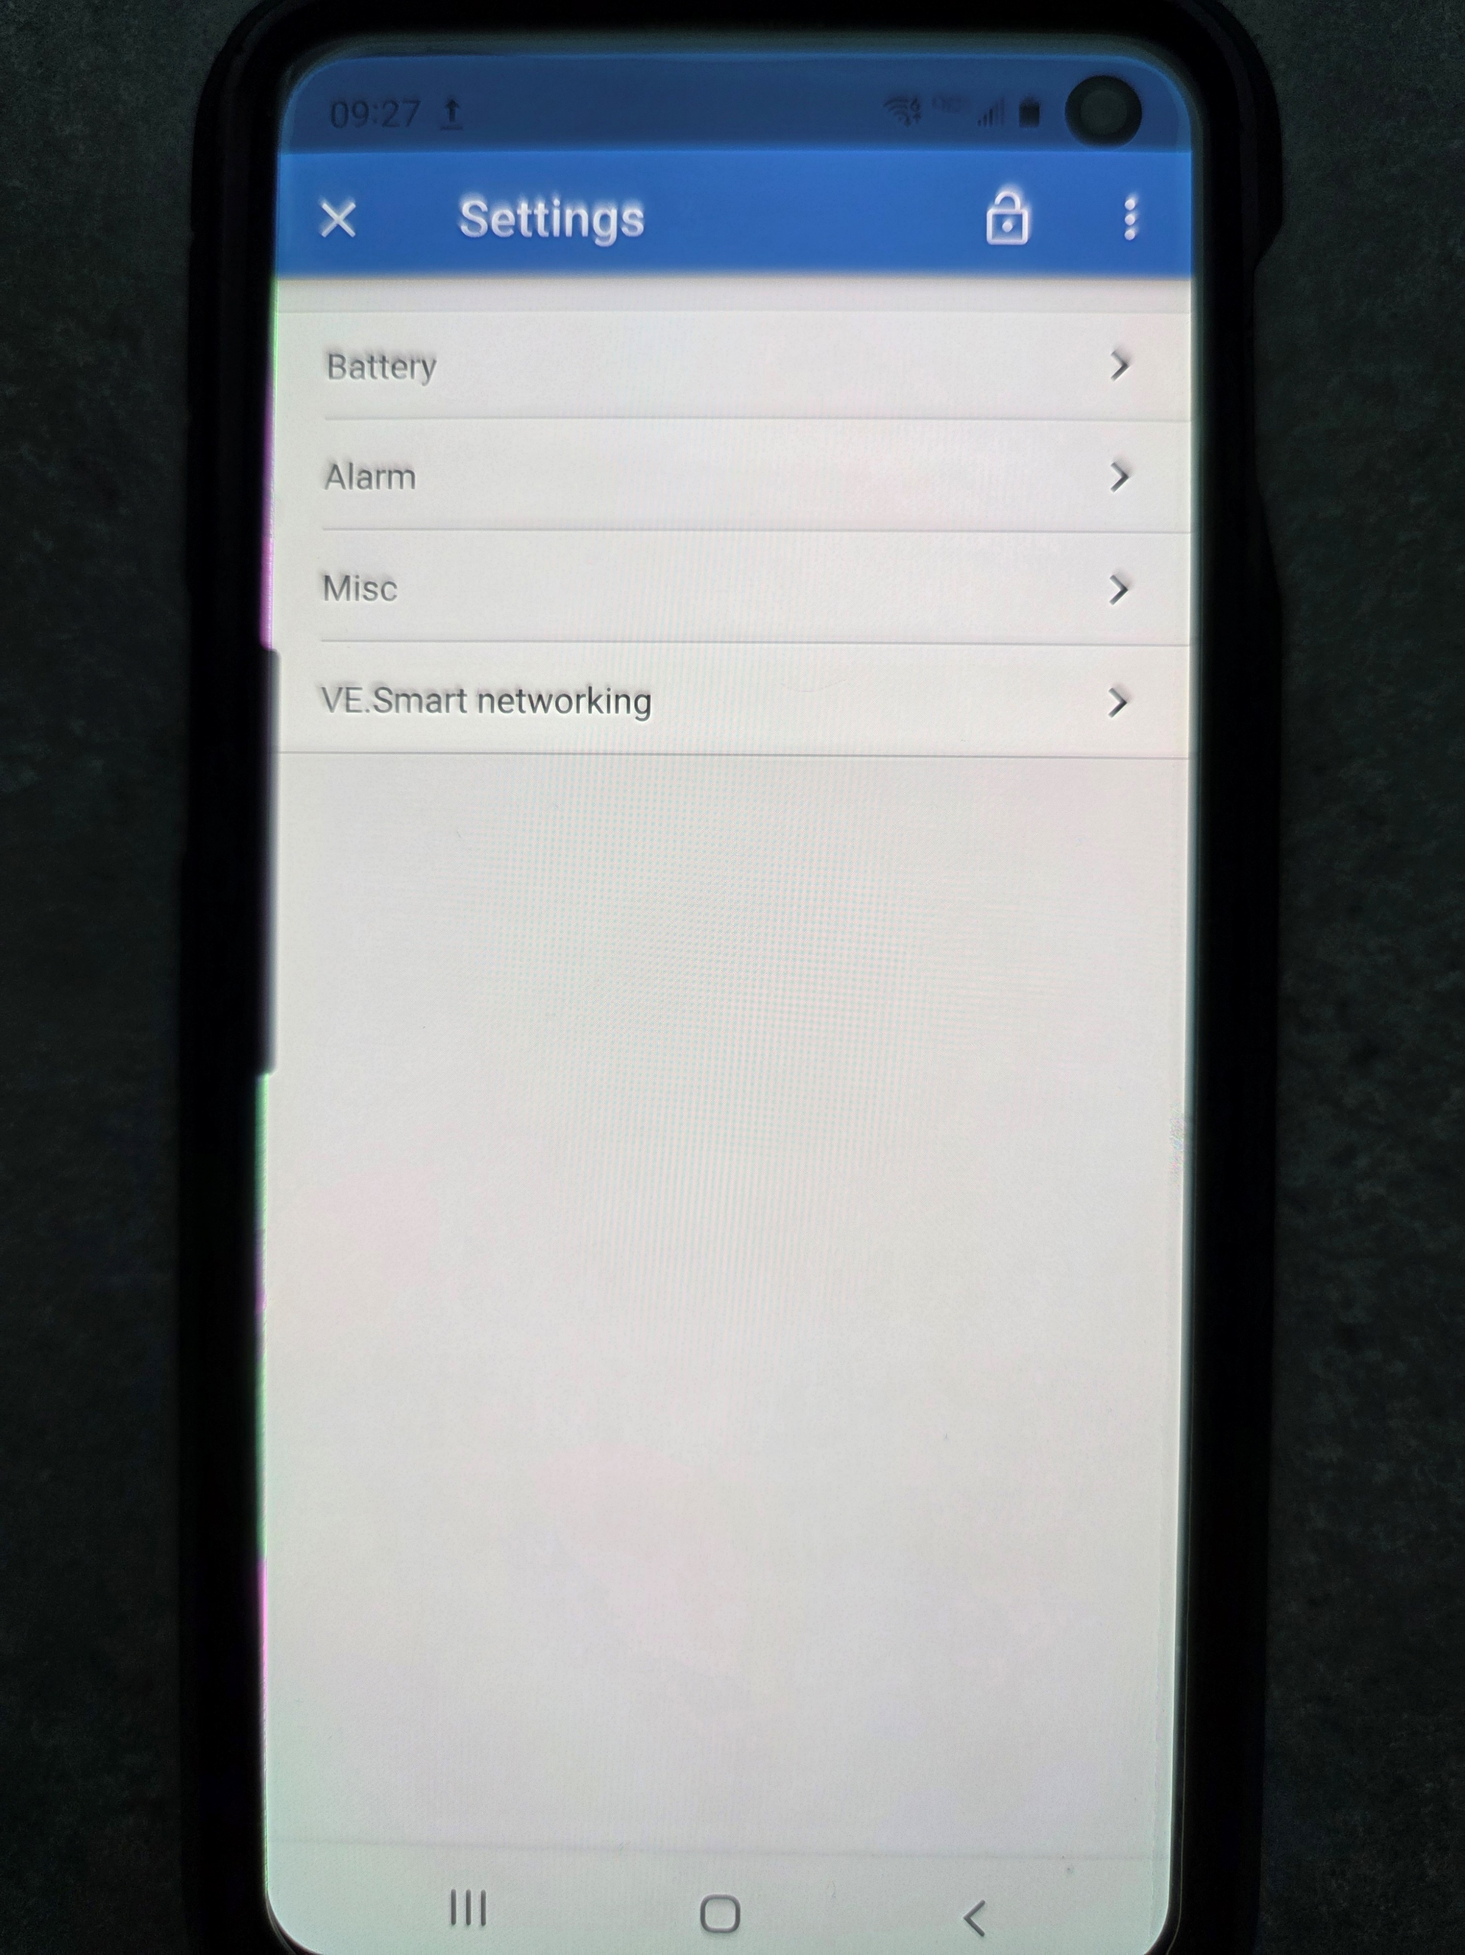
In the settings screen, select “Battery” using the right hand arrow

Slide 10
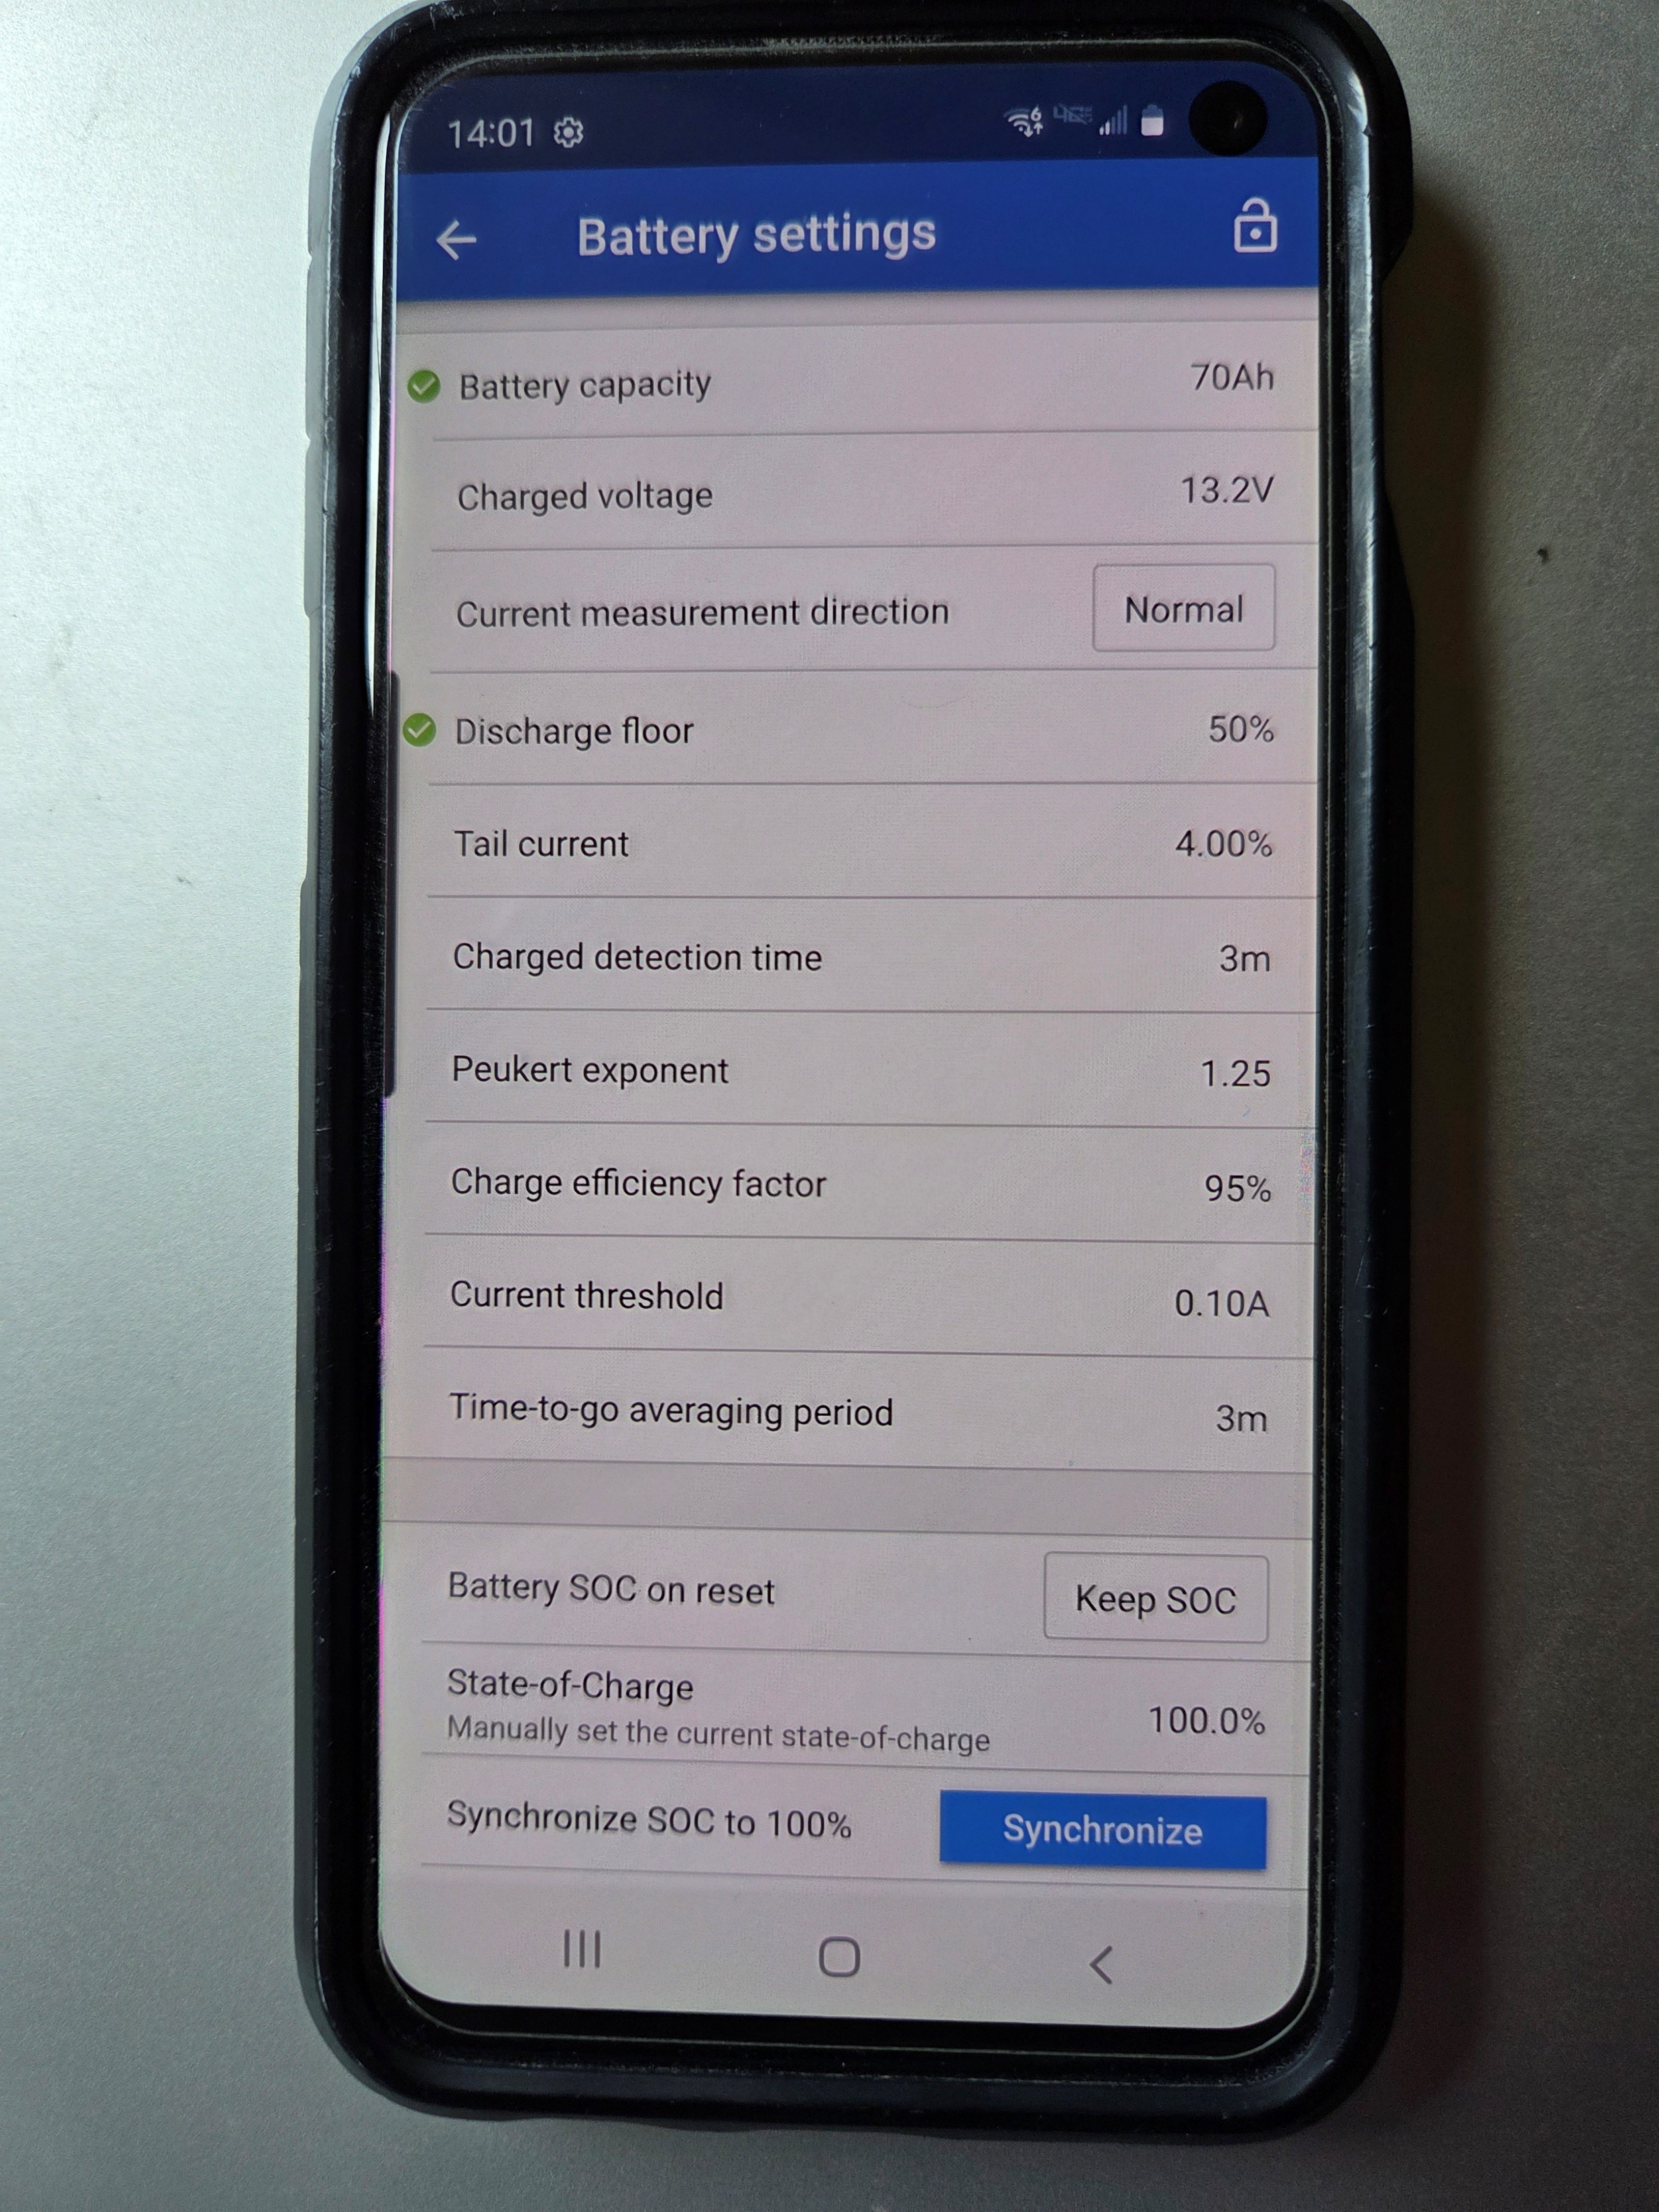
Default Victron Smartshunt Battery Settings. You Will Need To Make Some Changes, defaulted to a lead acid battery

Slide 11
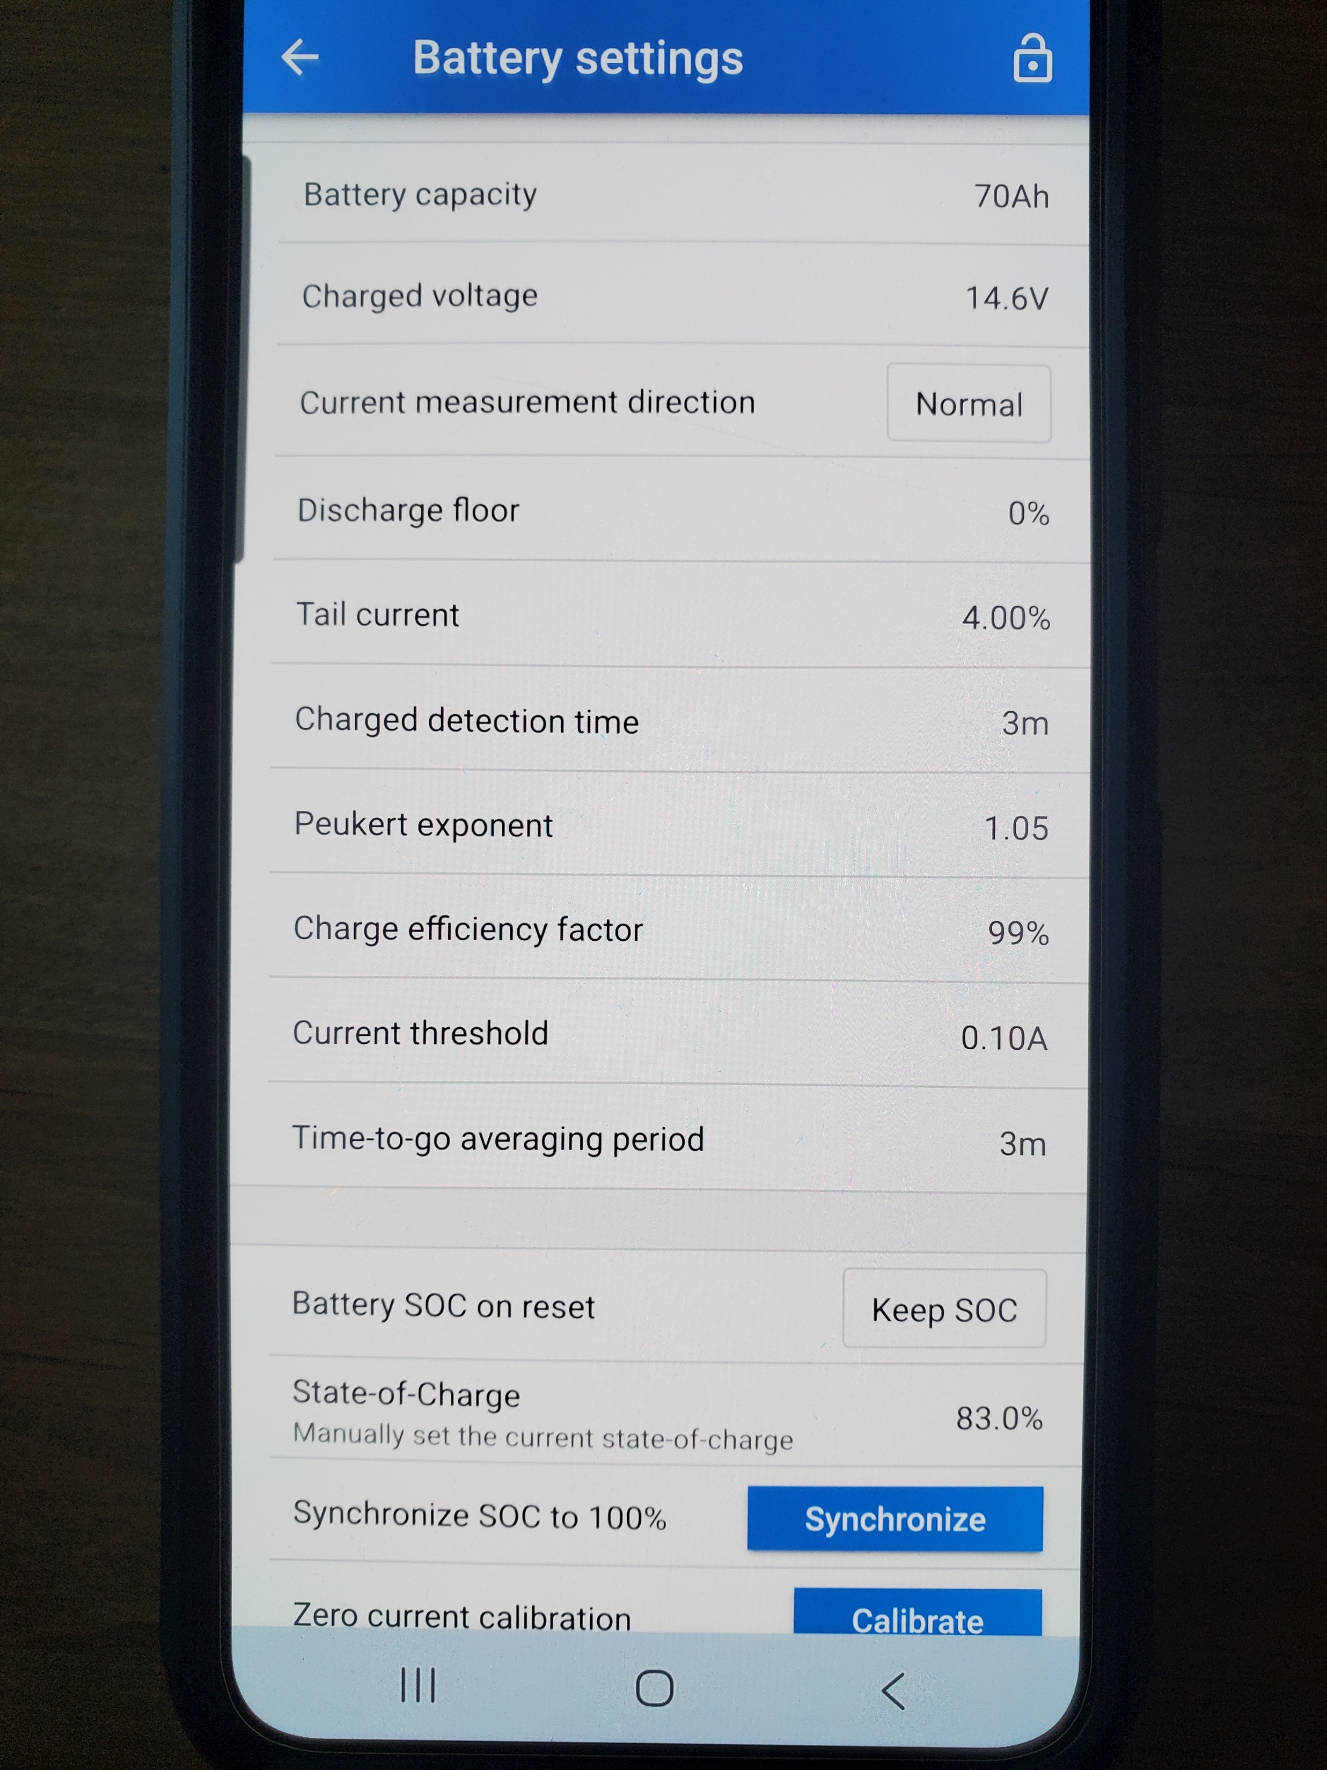
Battery Settings You Want For A Bioenno Power LFP Battery…70Ah Example

Slide 12
How calibrate your SOC (State Of Charge) with the Victron BT Smartshunt
First step is charge up your battery to 100%
If using a plug-in wall charger, you will see a red light on the charger while charging, when the charger detects a low enough current, the light will turn green
LFP batteries need “cell balancing” from time to time
Once the charger light turns green, wait about 20 minutes to complete cell balancing…each cell needs to come to the same SOC
Two settings you need to select SOC menu setup

Slide 13
Note “Battery SOC on reset”

Slide 14
Menu choices with Battery SOC on reset
Keep SOC, the default setting, will keep and remember last know value…this is the one I choose
Clear…SOC will be unknown until the synchronization levels are reached (No thank you)
Set to 100%...SOC is set to 100% (No thank you)
I want my powerboxes to show me the last known SOC for my LFP battery, I can then decide to use it as is, or charge it up to 100% and synchronize the SOC

Slide 15
Note Synchronize SOC to 100%
After you have fully charged your battery and given opportunity for your LFP battery to do cell balancing, then I press the blue “Synchronize” button…you now know the shunt is set to show the true SOC of your battery
The current draw on the Victron BT Smartshunt is < 1mA
If the shunt was left connected to the battery over a long period of time, the actual SOC could be less than the displayed SOC…
If the powerbox has not been used in awhile, just top up the battery, allow 20 minutes for cell balancing and then press the Synchronize button and you are ready to go out and do portable ops

Slide 16
Download the Victron Connect App to your Android or Apple phone
How to set up your Victron Connect app for your Victron BT Smartshunt

Slide 17
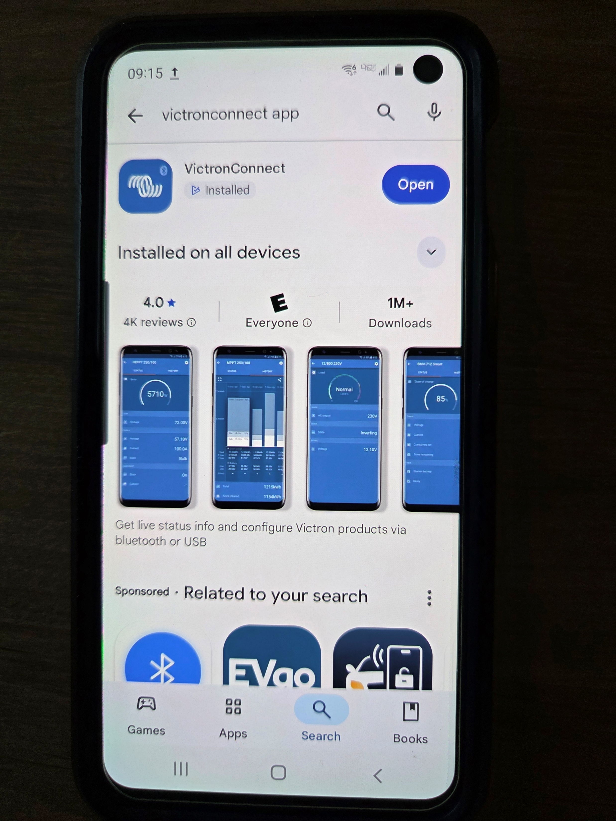
Android phone Victron Connect app downloaded, now “Open”

Slide 18
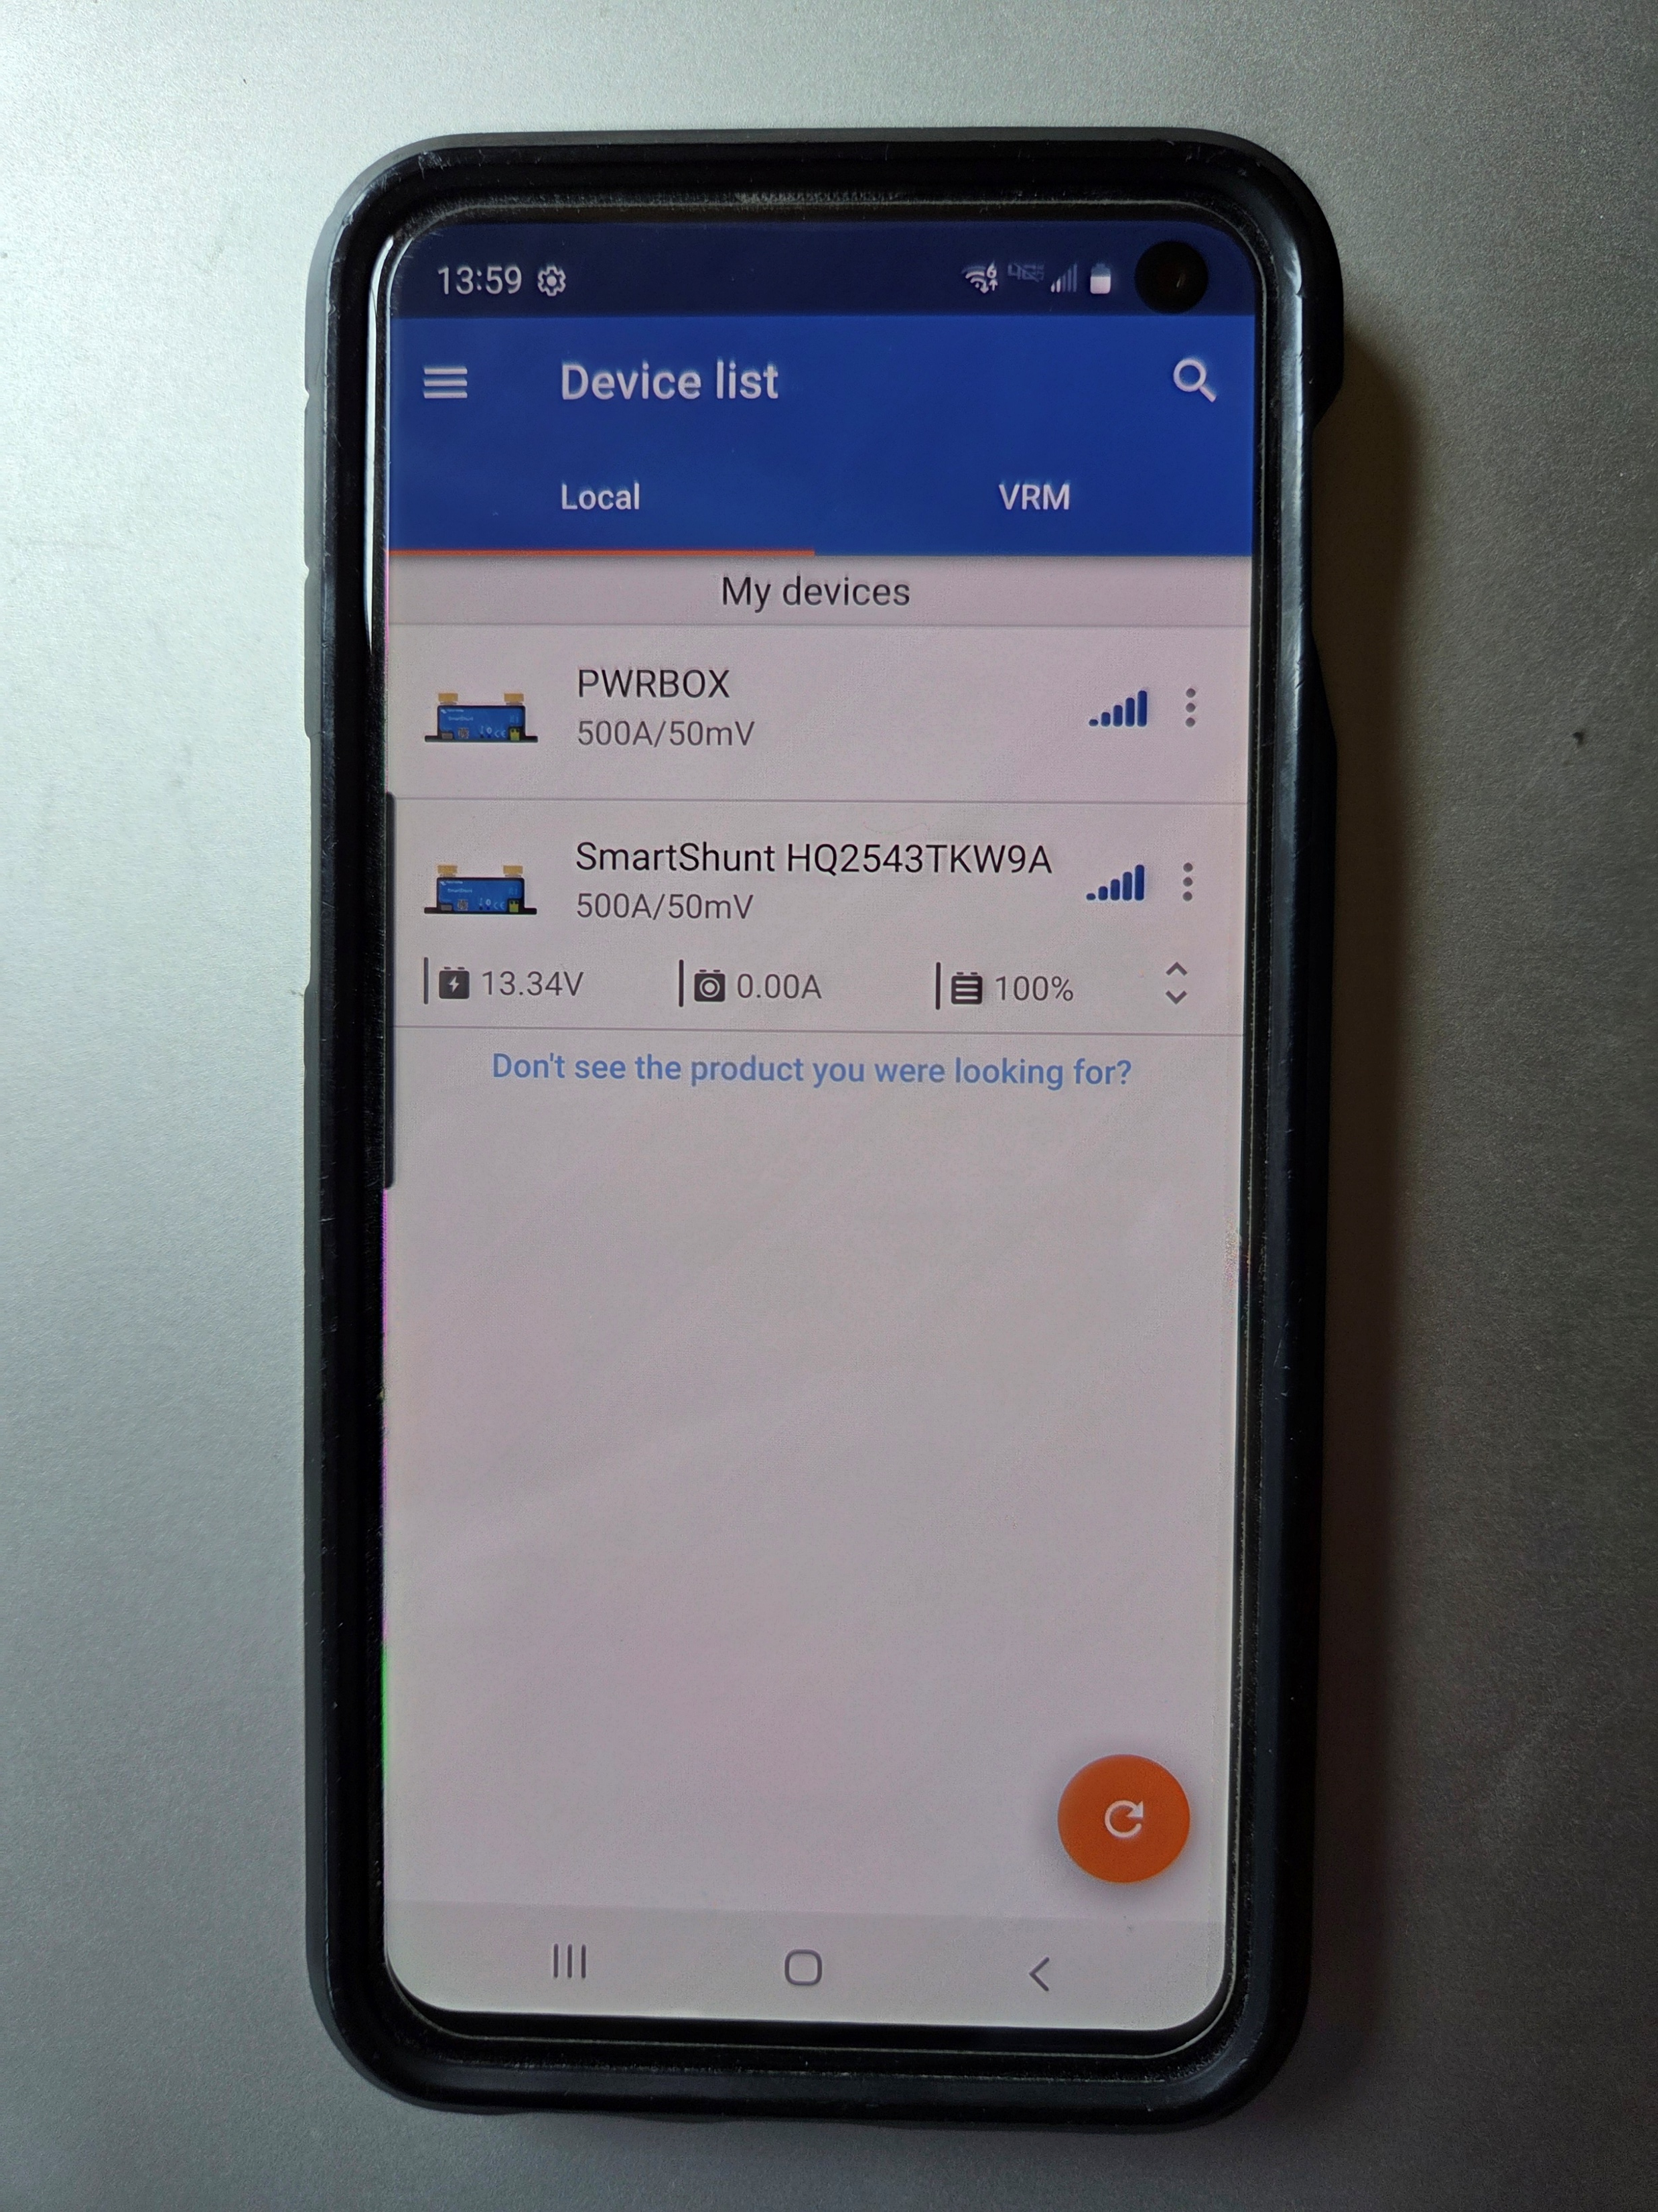
When You Open Up The Victron App You Will See A Device List…Just Click To Select A Device

Slide 19
When Making A First Connection You Will Be Asked For A Pin Code (Android example) to pair the device
The first connection screen will ask for a pin code and suggest 0000 or 000000. The newest Victron Smartshunt insert provided a printout showing a starting pin code, and the code on the side of the unit
You can then change the BT pairing pin code in the menu system
Will be showing how to give a custom name to each Victron BT Smartshunt device

Slide 20
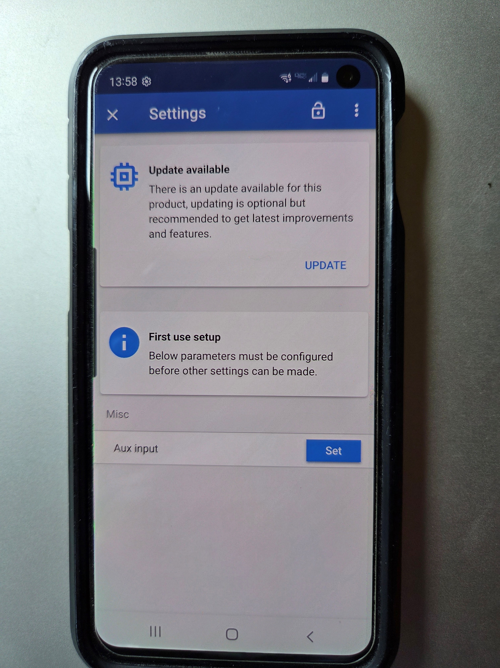
Once Connected, Setup Screen Asks For Battery Ah and Aux Input, I Already Answered Battery Ah, Then Took This Pic (Android Phone),Aux Input select “none”

Slide 21
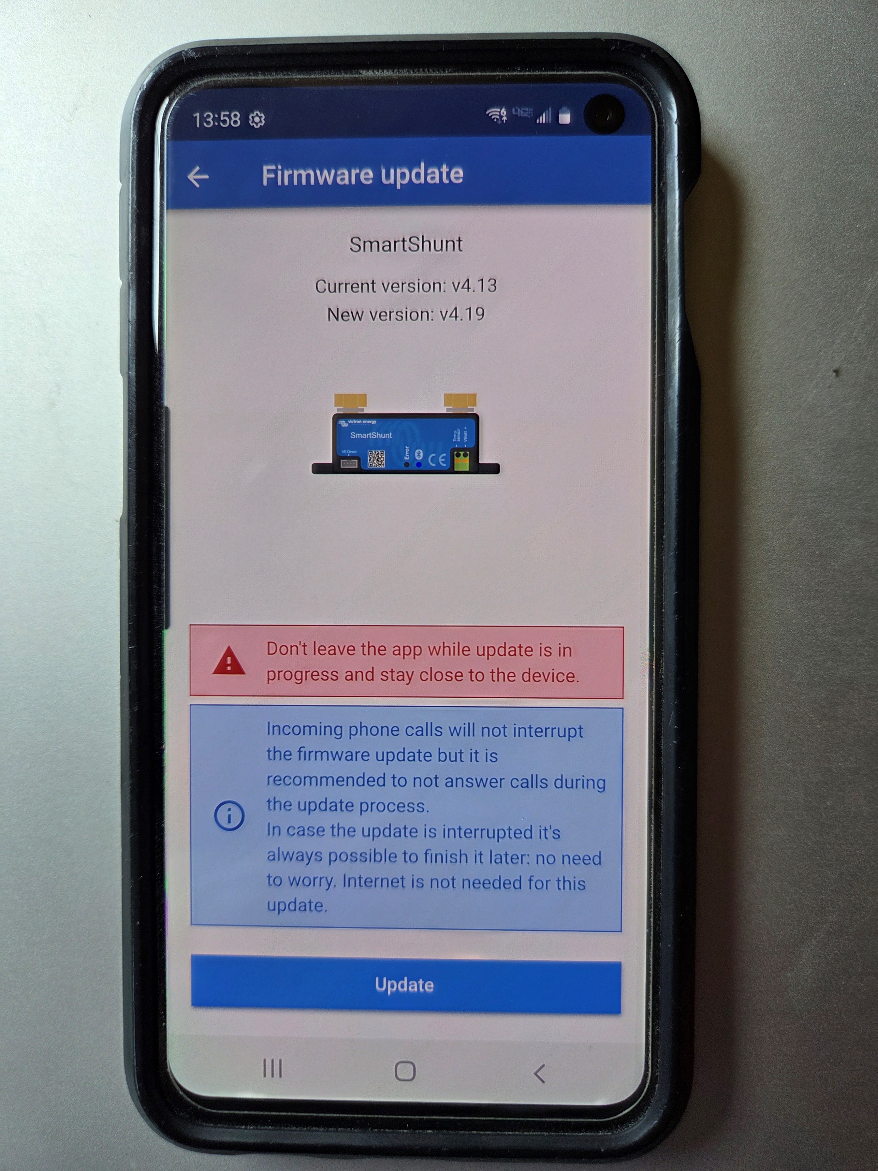
Firmware Update Screen

Slide 22
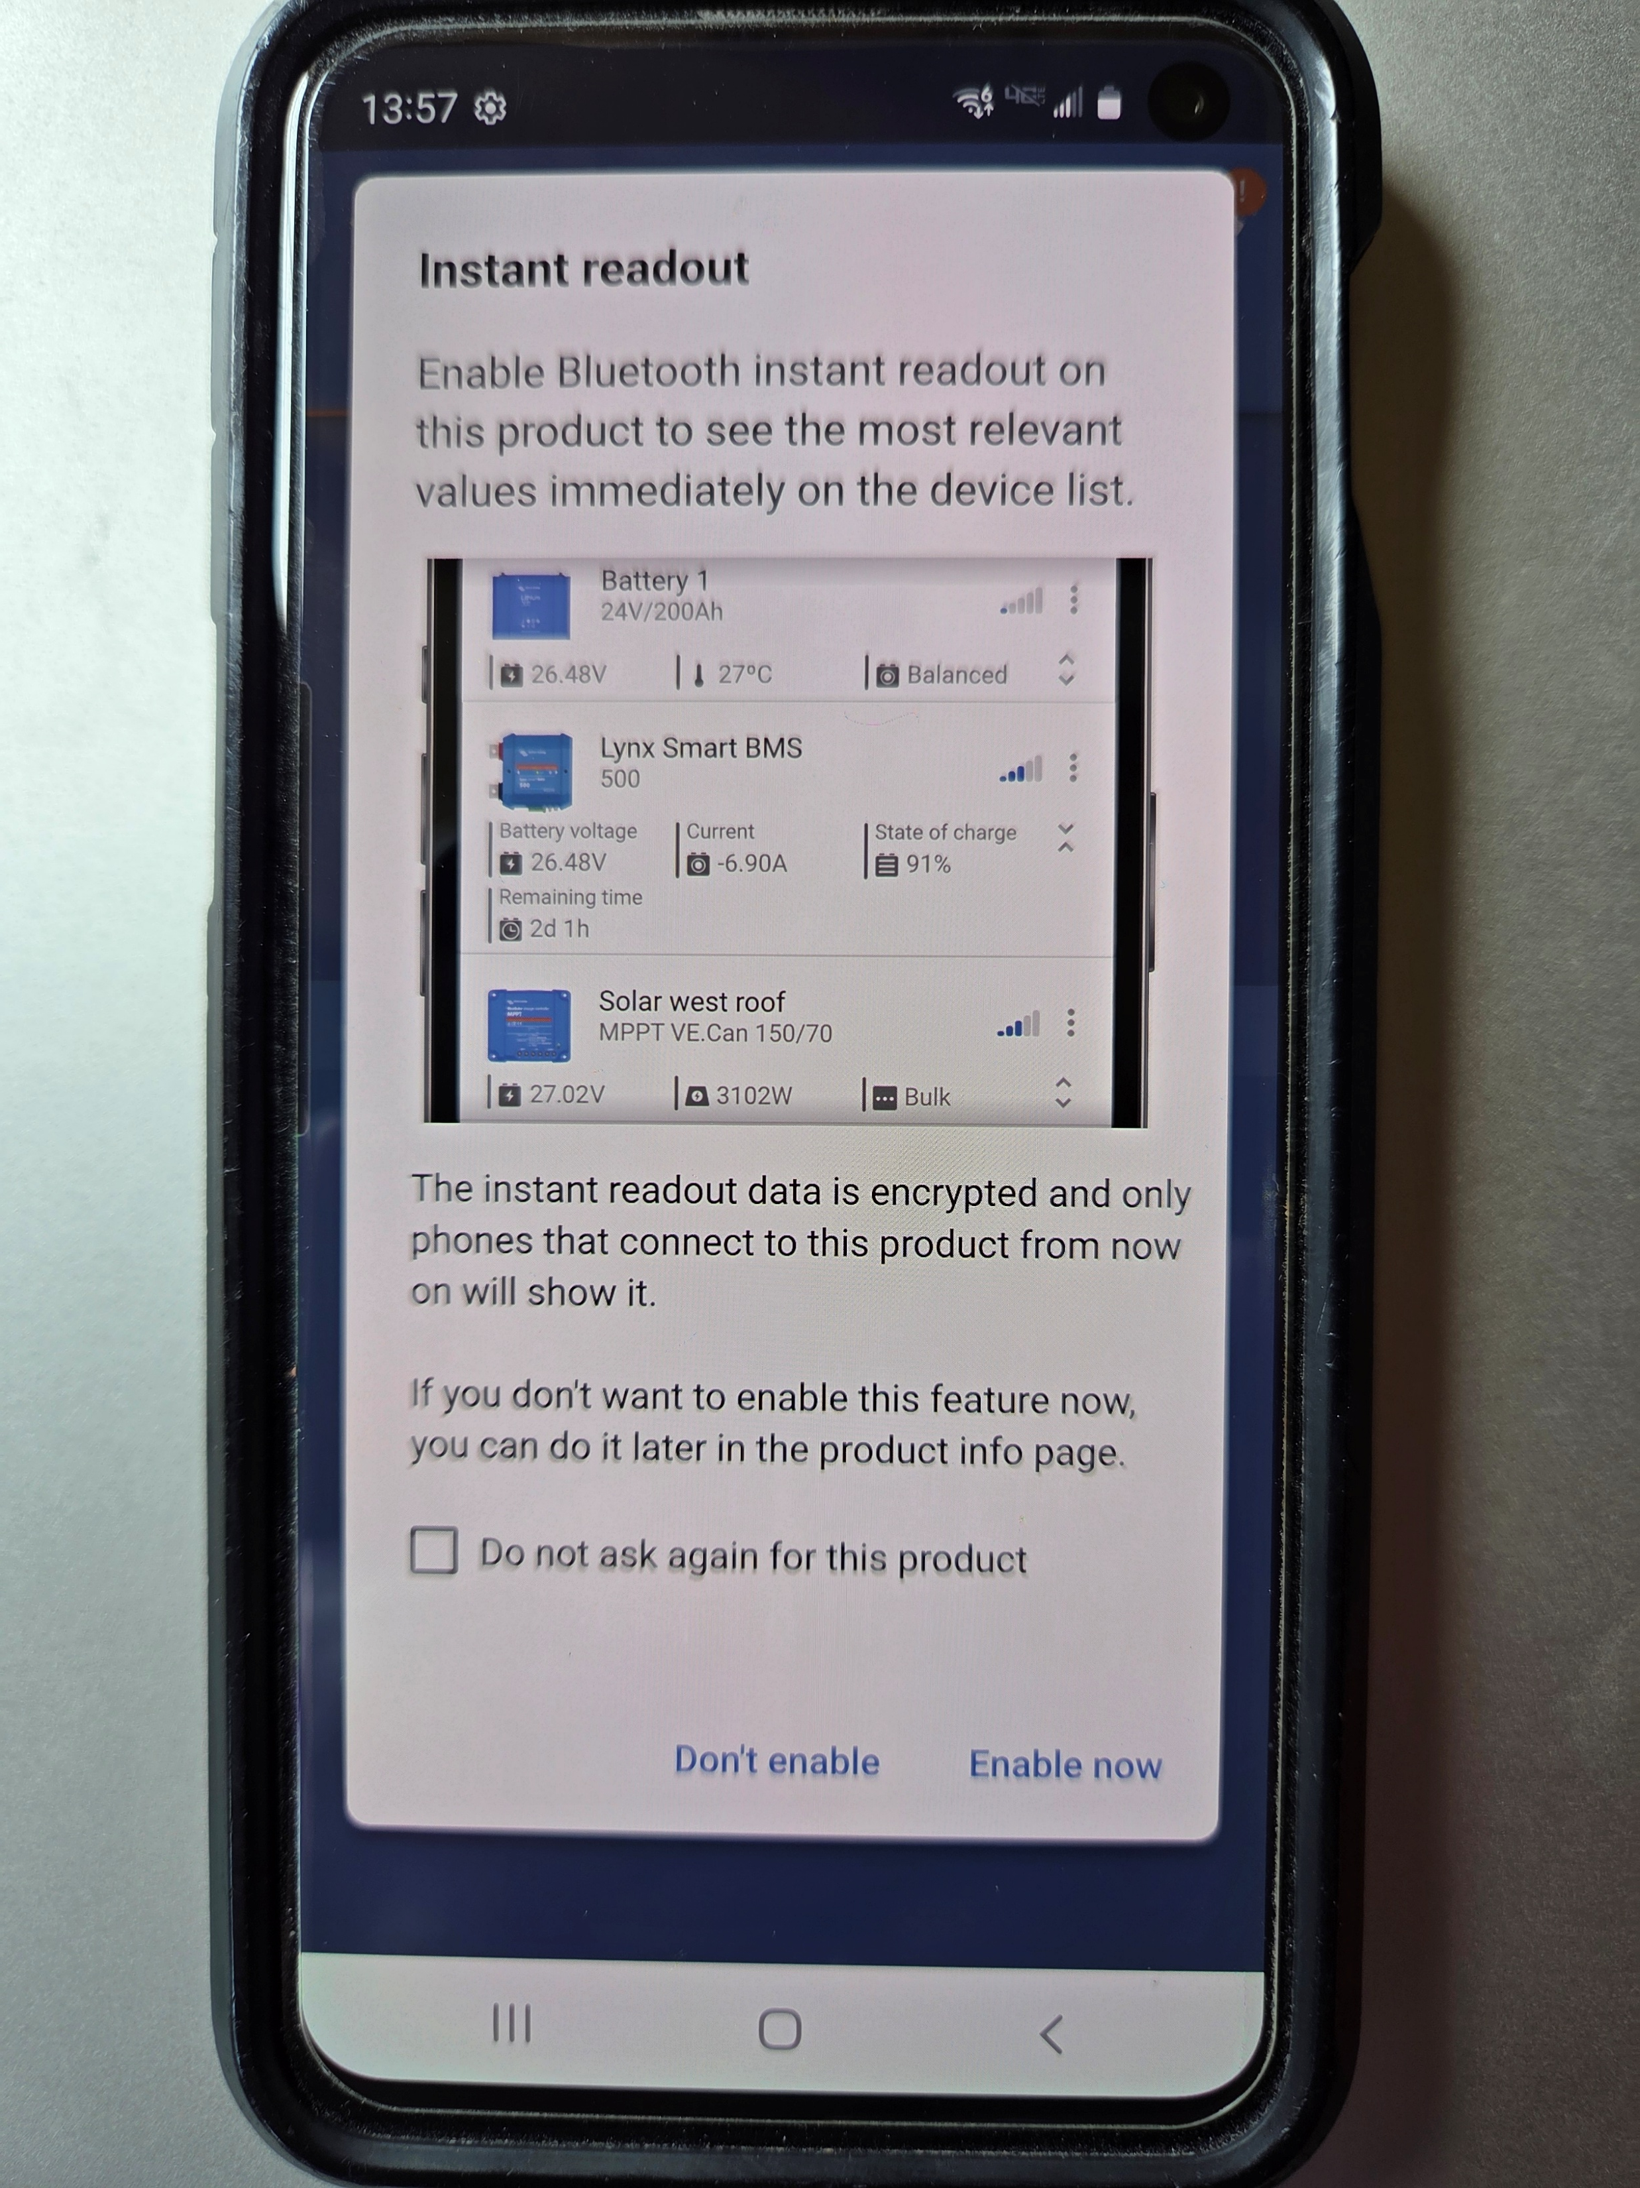
Instant Readout Option, I Would Say Yes

Slide 23
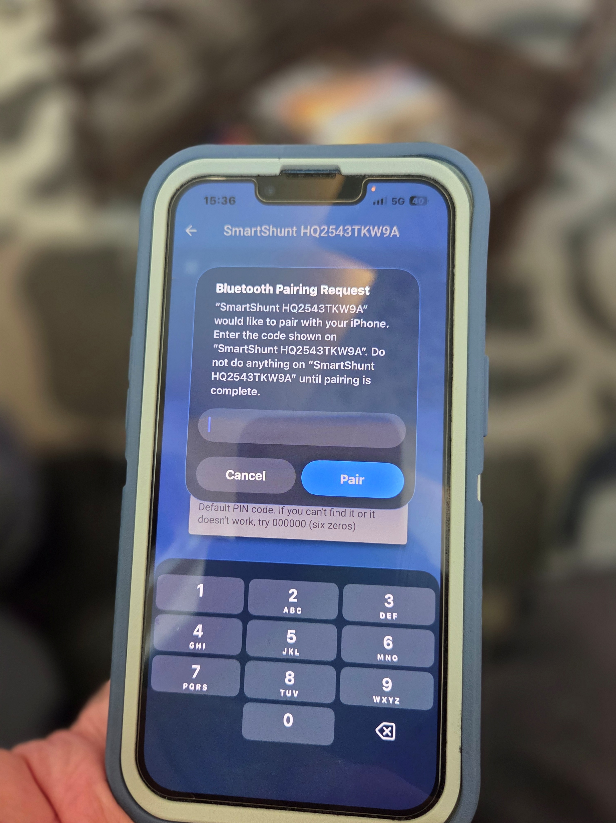
Apple Phone with Victron Connect app downloaded, device selected and then asks for the pin code to pair the device

Slide 24
You can customize the name for each Smartshunt, one of these two devices has a custom name

Slide 25
Steps to change the name for your Victron BT device…Go to the Victron Connect main screen and select a device

Slide 26
On the device main screen, click on the upper right gear symbol (Settings)

Slide 27
On the settings screen, click on the upper right three vertical dots

Slide 28
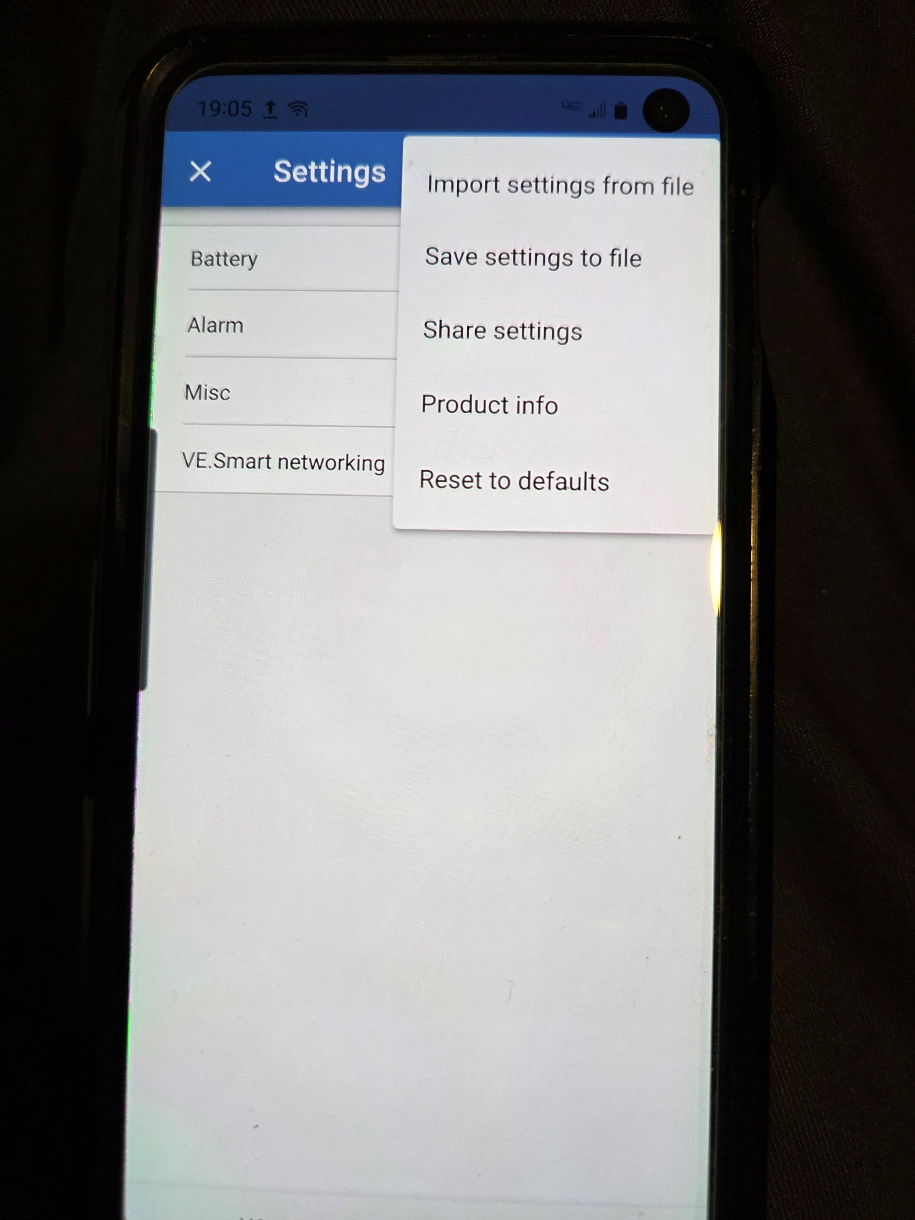
You will now see additional menu items from the “Settings” screen, select “Product info”

Slide 29
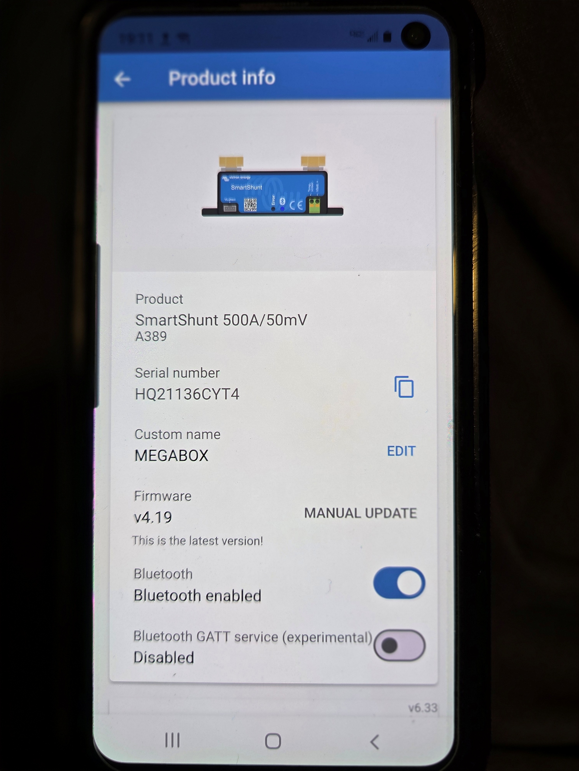
The “Product info” selection will show two screens, here is the upper screen, you select EDIT to create a custom name, right now is MEGABOX

Slide 30
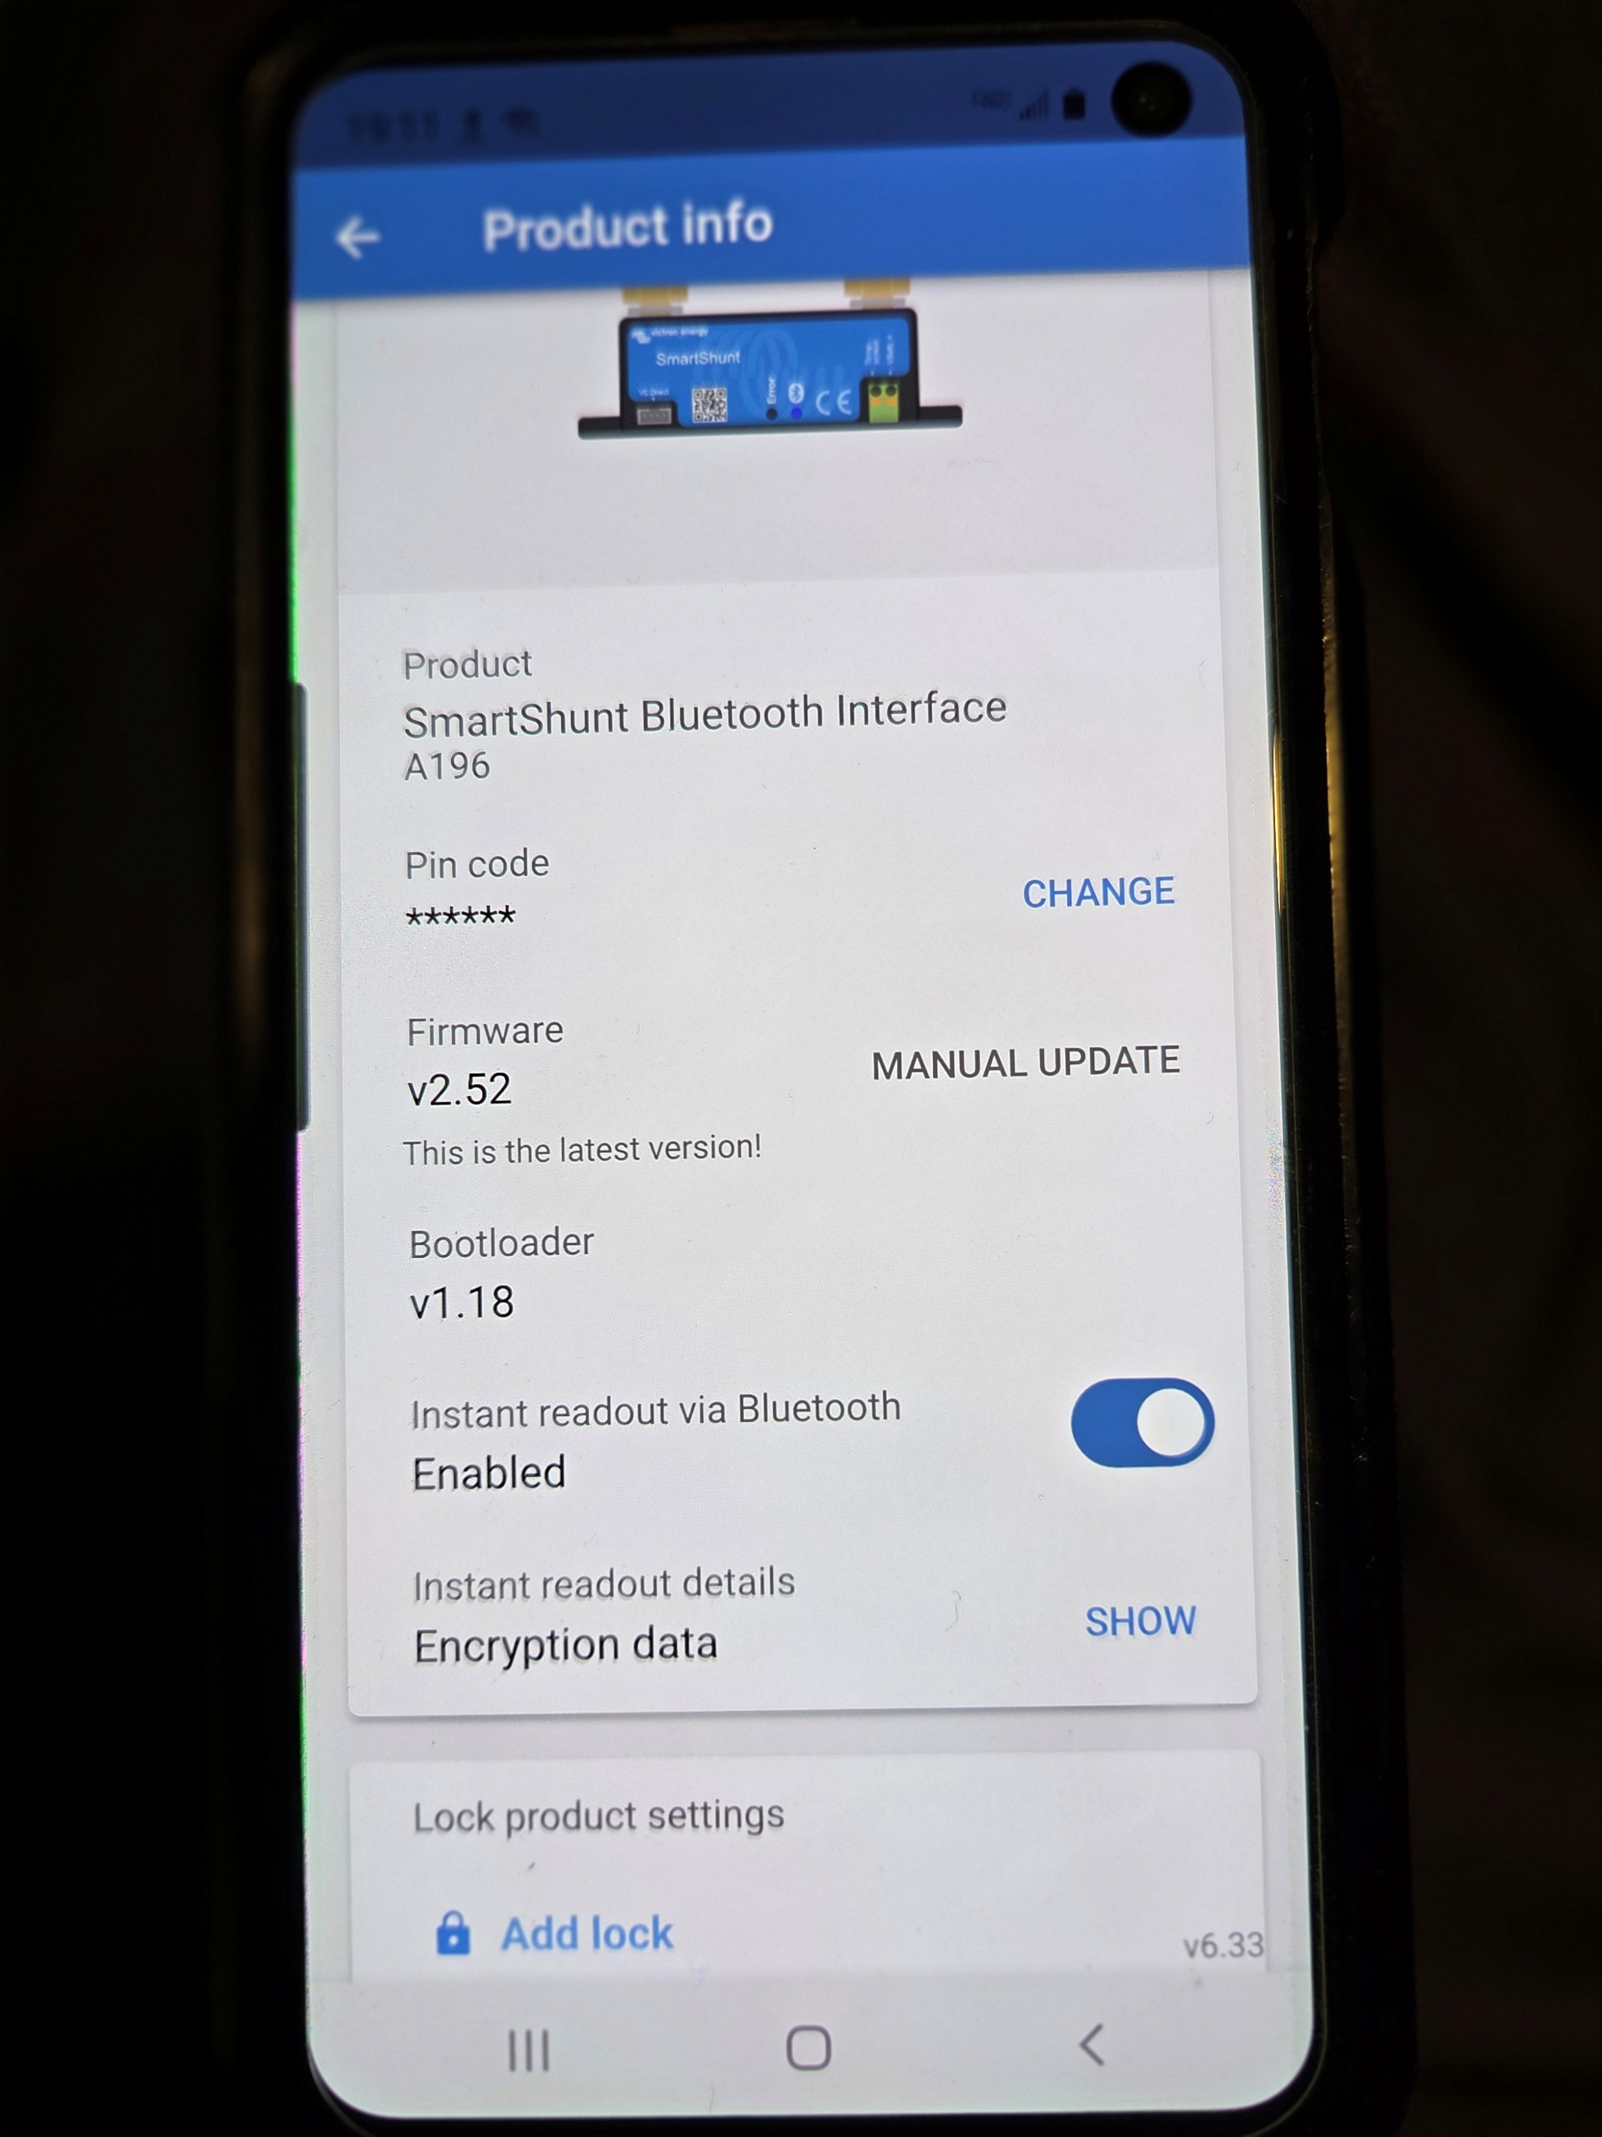
You can scroll down to the lower screen, here you can change the pin code

Slide 31
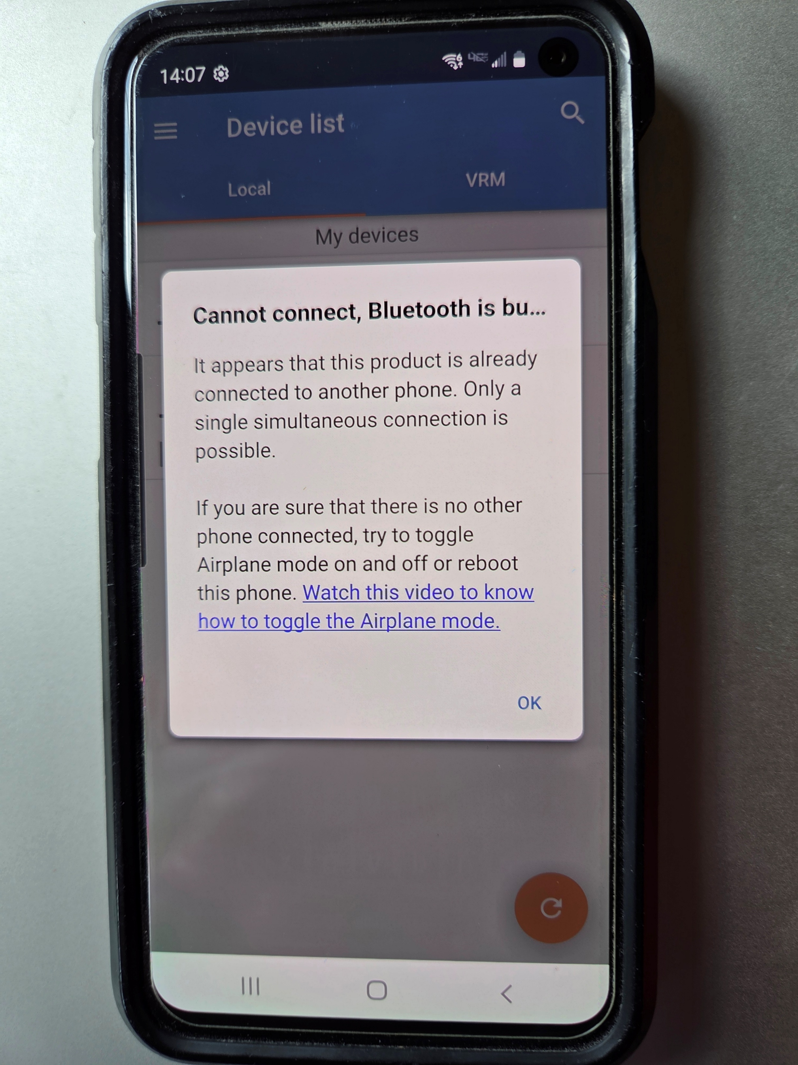
You Can Only Have One BT Connection At A Time…Otherwise You Will See This Screen

Slide 32
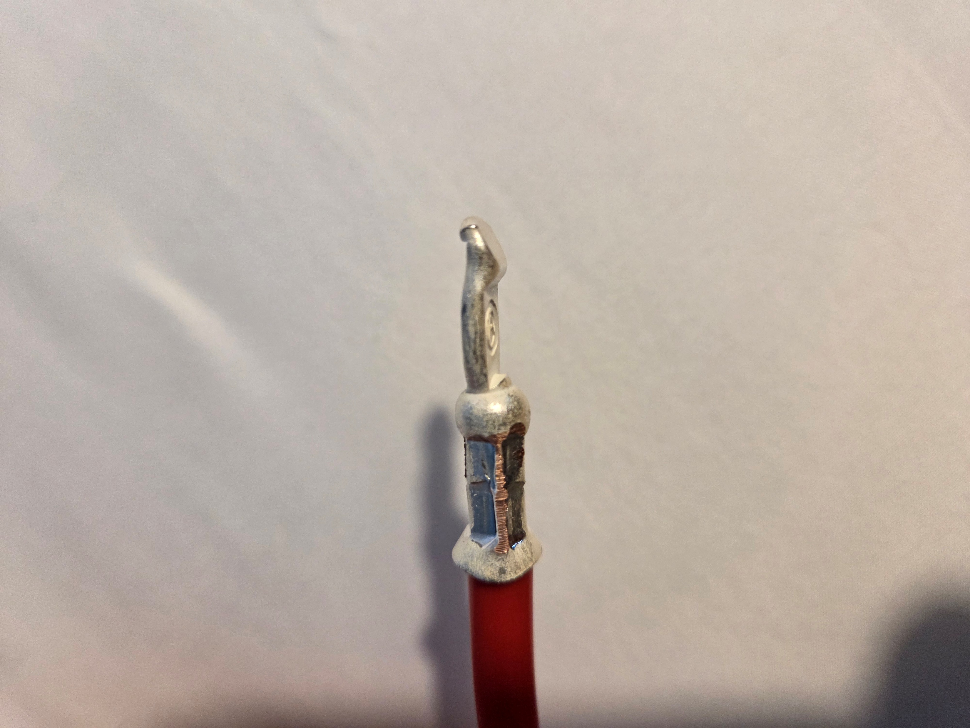
Set up wiring…note the small bulge to the right, the flat terminal contact point

Slide 33
PWRbox wiring method I use
Cut an 8AWG Red wire 5” long and strip back each end just enough to put on an SB50 contact
Both contacts will share the same orientation, the flat point is facing the same direction
Will cut two lengths of 8AWG Black wire to 4 ¼” and strip back enough wire to put a contact on one end and a 3/8” lug on the other end
One black wire will have the flat end 90 degrees to the right of the lug
The other black wire will have the flat end 90 degrees to the left
Place the black wires on the shunt terminal facing towards the center of the box…PWRbox is not wide enough for wires to point outwards

Slide 34
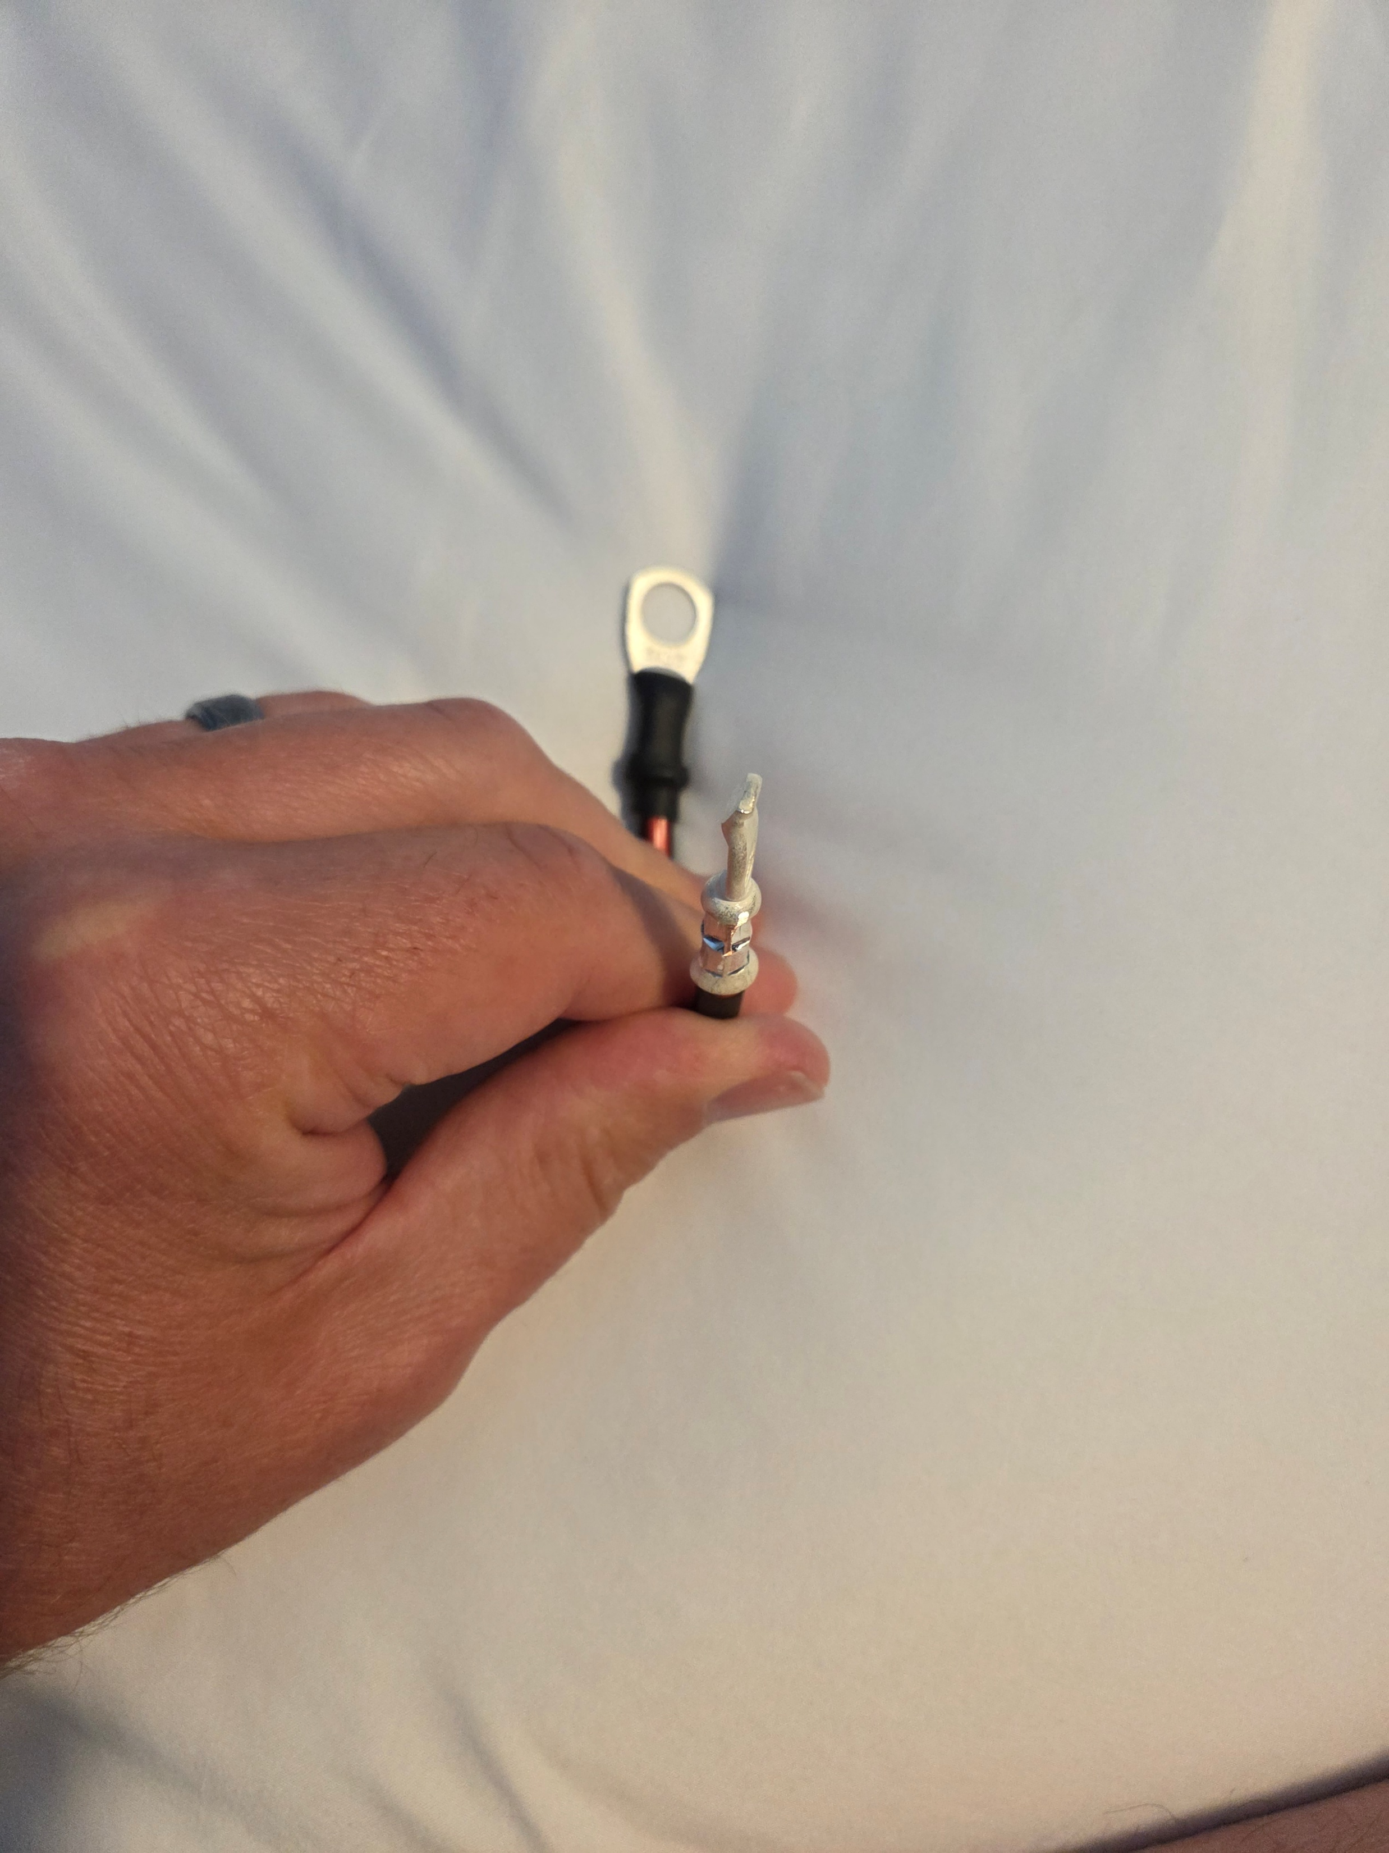
Looking at the contact in front of the lug, the flat end is facing 90 degrees to the left of the lug

Slide 35
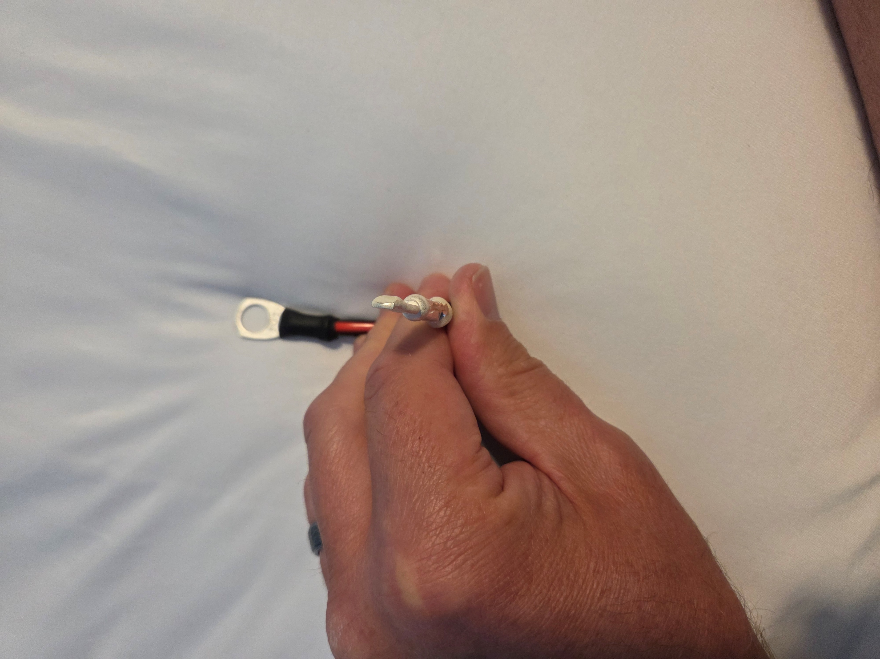
Other Black wire with flat end facing 90 degrees to the right of the lug

Slide 36
Megabox wiring instructions
Cut an 8AWG Red wire 7” long
Place an SB50 contact on each end, each contact will be 180 degrees different in orientation…if the wire is laying flat, one end has the contact surface facing up and the other end has the contact surface facing down
Cut two 8AWG Black wires 4.5” long
Place an SB50 contact on one end facing 90 degrees to the right of a 3/8” lug that would be behind it
Do this for both Black wires, 90 degree turn to the right
When connected to the shunt with the wires going away from shunt terminals, you will be able to

Slide 37
Final note
Before you put your Victron BT Smartshunt in a powerbox, you will need write down and save the shunt PUK
The PUK is the Personal Unblocking Key
If you forget your BT pairing pin code, you will need the PUK to confirm you are looking at the device, and after entering the PUK, you can then reset the BT pin code
Anyone nearby will be able to see your device name, but not be able to make a connection…they do not have your pin code or your PUK

